Slide 1
Microsoft Azure Service Fabric
Dr. Rishi R. Sinha
Principal Software Engineering Manager, Microsoft

Slide 2
Agenda
Microservices
Introduction to Service Fabric
Demonstration of Platform Capabilities
Service Fabric Architecture
Wrap-up
Notes:
We are here to show you how to use the Service Fabric programming models to build applications, that are composed of microservices. Building applications with this approach enables to build hyperscale services for the cloud. What do you mean by a hyperscale service? Hyperscale services are “born in the cloud” services that have all the demands of enterprise Tier-1 applications and have the ability to run at huge scale as well as be flexible based on demand and changing requirements. You can start small, however given that scale is unpredictable and re-architecting your applications is costly, you an approach and a platform to help you achieve this.

Slide 3
Microservices
Notes:
10 min

Slide 4
The trouble with monoliths…

Slide 5
The trouble with monoliths…
Tightly coupled components
All components updated together
Not agile, time to market suffers

Slide 6

The trouble with monoliths…
Tightly coupled components
All components updated together
Not agile, time to market suffers

Slide 7
The trouble with monoliths…
Tightly coupled components
All components updated together
Not agile, time to market suffers
Scale by cloning entire apps
All components scaled similarly → expensive

Slide 8
The trouble with monoliths…
Tightly coupled components
All components updated together
Not agile, time to market suffers
Scale by cloning entire apps
All components scaled similarly → expensive

Slide 9

Microservices…
Do one thing well
Manage independent code and state
Are generally developed by a small cross-functional team
Are built with task-appropriate languages/frameworks
Notes:
Microservices applications are composed of small, independently versioned and scalable services that communicate with each other over standard protocols with well-defined interfaces
.
You as a developer think about code and data
You think about how you are going to upgrade it independent of other microservices
It is code that is versioned and scaled independently, having n copies of the service
You need to know how to find its endpoint by name
Microservices are code and config hosted in containers - When I say container I mean it in the broader sense of the word, may be processes, maybe in a Windows Job Object or may be a Windows or Linux container
Microservices is a great way of codifying this thinking
We think Microservices should be logically consistent

Slide 10
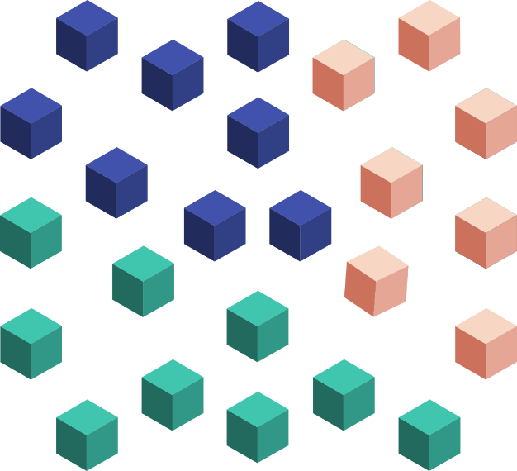
Microservices…
Do one thing well
Manage independent code and state
Are generally developed by a small cross-functional team
Are built with task-appropriate languages/frameworks
Are loosely coupled
Communicate over well-defined interfaces/protocols
Have unique names (URI) that can be resolved
Are independently updated
Are independently scaled
Notes:
Microservices applications are composed of small, independently versioned and scalable services that communicate with each other over standard protocols with well-defined interfaces
.
You as a developer think about code and data
You think about how you are going to upgrade it independent of other microservices
It is code that is versioned and scaled independently, having n copies of the service
You need to know how to find its endpoint by name
Microservices are code and config hosted in containers - When I say container I mean it in the broader sense of the word, may be processes, maybe in a Windows Job Object or may be a Windows or Linux container
Microservices is a great way of codifying this thinking
We think Microservices should be logically consistent

Slide 11
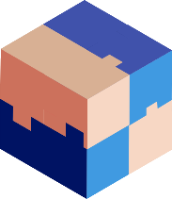

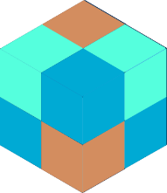








Scaling Monolithic Apps
Scaling Microservice Apps
App 1
App 1
App 2

Slide 12
Monolithic application
Microservices application
State: Single monolithic database
Tiers of specific technologies
Graph of interconnected services
State typically scoped to the service
Variety of technologies used
stateless presentation services
stateless services
stateful services
stateless services with
separate stores
Notes:
Make this more generic

Slide 13
Goodness…
Increase agility through componentization
Simplify upgrades through independent versioning
Maximize productivity through heterogeneous technologies
Improve hardware utilization through granular resource balancing
Limit the impact of failures through isolation
Notes:
Increase agility:
You can match services to team boundaries
Interservice boundaries defined by strong service contracts ensure that individual teams can make changes under the hood without worrying about weird dependencies
Simplify upgrades:
By upgrading your application surgically, upgrades don’t need to be white-knuckle affairs run overnight or on Saturdays
Maximize productivity:
The team working on the customer service are all PHP experts? They can use that. The team building the payments service needs to use a legacy C++ library? They can build their service in native. You should never have to compromise on productivity for the sake of consistency.
Improve hardware utilization:
In the previous slide, we looked at how monolithic apps are scaled, by deploying multiple copies and load balancing. But if if you have a particular code path that is particularly hot, you need to scale out the HW for the whole application based on that bottleneck rather than just scaling that service.
Limit the impact of failures
- In a monolithic app, failures often impact the whole app. With microservices, failures are isolated, both because a crash in one place doesn’t bring down the whole application and because the more explicit boundaries force teams to think about fault tolerance.

Slide 14
However, devs now need to code for…
Service discovery
State management
Service lifecycle management
Manage massive scale (Load reporting)
Health reporting
Resource usage reporting
Failure resiliency

Slide 15
However, devs now need to code for…
Service discovery
State management
Service lifecycle management
Manage massive scale (Load reporting)
Health reporting
Resource usage reporting
Failure resiliency
Wouldn’t it be nice to have a microservices platform that does all this?

Slide 16
Service Fabric Intro
Notes:
10 min

Slide 17



Azure Service Fabric
Lifecycle
Management
Always On Availability
Orchestration
Programming Models
Health & Monitoring
Dev & Ops Tooling
Auto
scaling
Dev Box
Azure
On Premise
Data centers
Other Clouds

Slide 18
Azure Service Fabric Microservices
Web Apps
ASP.NET Core
- OWIN
Reliable Actors
Guest Executables
(Any Code)
Reliable Services
Containers
(Windows Containers & Docker)
Lifecycle
Management
Always On Availability
Orchestration
Programming Models
Health & Monitoring
Dev & Ops Tooling
Auto
scaling
Dev Box
Azure
On Premise
Data centers
Other Clouds

Slide 19
Services built with Service Fabric
Skype for Business
Hybrid Ops
Azure Document DB
billions transactions/week
Intune
800k devices
Azure Core Infrastructure
thousands of machines
Event Hubs
20bn events/day
Bing Cortana
500m evals/sec
Azure SQL Database
1.4 million databases
Power BI
IoT Suite

Slide 20












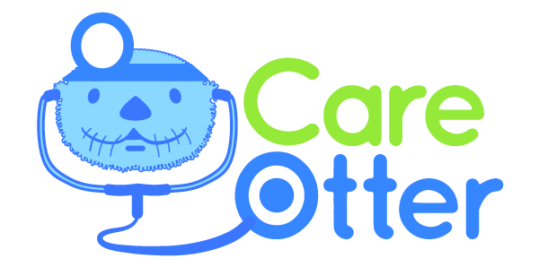

Notes:
Service Fabric customer in production

Slide 21
Categories of services
Guest executables and guest containers
Deploy and manage arbitrary services written in any framework
Stateless Services
State persisted to external storage, such as Azure DBs
Existing web (ASP.NET) and worker role applications
Stateful Services
Reliability of state through replication and local persistence
Lowers latency
Reduces complexity in traditional three tier architectures
Notes:
With that short background, let talk about what and how you can build applications with Service Fabric
First stateless applications are no different from the web and worker roles that you build today, in that the state is retained in an externalized store such as SQL Azure or Azure storage. This is a fine approach for certain application designs and of course you still need to handle scaling out each tier. Serivce Fabric brings benefits to the stateless approach with its microservices architecture by enabling fast deployment time (applications are now deployed in seconds) as well as much, much higher density. You can package 1000s of microservices on a VM, where are with Cloud Service today you are forced to have only one service per VM, underutilizing the resources
Stateless services are where you let Service Fabric take care of the application state through replication and local persistence. This is really the democratization of high availability. Everyone, not just databases and high ends stores, can now have HA in your applications through simple programming models with full data consistency. Think about this. Your apps do not need to do lots of data manipulation to write data to another store.
Stateful services are recognition that there are limitation with just a pure stateless service design to address two issues. Reduces latency of your applications and makes it more responsive to users, since data is locally stored. Reduces complexity of you application since you no longer need to have additional caches (which only deal with read latency) and additional queues in order to make your services reliable. You literally remove these extra services from your design, making the overall service simple and have a SINGLE approach to management.
Finally although Service Fabric provides a runtime for you to build applications, this does not prevent you from using other runtime in you applications. So you may have a service that has a node.js front end that communicate with backend stateless and stateful services. Or you may deploy application that run in Java VM or simply deploy some EXE that you have that need to be used by your service. Service Fabric will makes these other runtime reliable, if needed, but ensuring that the specified number of instances is always running. You will get the full benefits of the deep resource balancing of the Service Fabric microservices built with the Service Fabric runtime and ALM capabilities; you can reuse existing code and have the benefit of a SINGLE approach to management. Not bad!

Slide 22






Traditional Service Pattern
Scale: Partition storage
Reliability: Use queues
Latency: Use caches
State consistency: Manage tx
Load Balancer
Front End
(Stateless
Web)
Stateless
Middle-tier
Compute
Cache
Many moving parts managed differently
Queues Storage
Notes:
<build slide>

Slide 23

An Alternative Approach: Stateful services
Latency: App state is in the compute tier
Scale: First class partition support
Reliability: Inbuilt in platform
State consistency: Built in transactions
Load Balancer
Front End
(Stateless
Web)
Stateful
Middle-tier
Compute
Simplify design, reduce complexity & errors
data stores used for analytics and disaster recovery
Notes:
<build slide>
All first party services are stateful

Slide 24

Service Fabric Cluster
FD1/UD6
Node
Machines stitched together
Scales to 1000+ machines
Single management endpoint
Layout limits impact of HW failures
FD0/UD0
FD1/UD5
Node
Node
FD0/UD1
FD2/UD4
Node
Node
FD2/UD3
Node
Notes:
A set of machines (physical or virtual) , that service fabric stiches together to form a reliable and fault tolerant unit called a cluster. These clusters can be scaled to 1000s of machines.
For example - SQL Azure has regional clusters that are made of 1000s of machines.
When setting up your cluster service fabric allows you to specify the failures that the cluster should survive. For example you can choose to set up a cluster that spans three azure data centers, so that the cluster can survive the loss of a data center.
Bing Cortana service runs on a cluster that spans three regions, making is tolerant of regional failures. Last year they had a widespread outage in one of the data centers , taking a third of the capacity down, but the service suffered no disruption. They service just failed over real time to the other two datacenters in the other regions. That is the kind of reliability you can get with azure service fabric.
More about the planning for production later in the session.
Let us now go to understanding what a service fabric application is made of..*

Slide 25
Demoing the platform….
Notes:
10 min

Slide 26




Cluster: System View
System Services
Failover
manager
Cluster
manager
Naming
Image
store

Slide 27
Look inside Service Fabric
Notes:
10 min

Slide 28
Thus far, you’ve seen…
General concepts & Service Fabric
Microservices (Stateful & Stateless)
Deployment, interaction with a Cluster
Named services & applications
System services
Health reporting
Failure detection & handling (w/ local state)

Slide 29
Thus far, you’ve seen…
General concepts & Service Fabric
Microservices (Stateful & Stateless)
Deployment, interaction with a Cluster
Named services & applications
System services
Health reporting
Failure detection & handling (w/ local state)
Now, let’s see how Service Fabric does some of these….

Slide 31
Service Fabric Architecture
Microservices
Application Programming Models
Management
subsystem
Communication
subsystem
Reliability
subsystem
Hosting & Activation
subsystem
Testability
subsystem
Federation
Transport
Notes:
Transport: A Secure point to point communication of datagram messages (standard SSDI channels), no assumption on messages being secure. Pieces of code in kernel and user mode. We use TCP since we get better performance because of TCP offload compared to UDP. (TCP is used as UDP – fragmentation, reuse, ack and nack provides TCP). Messages can be duplicated, out of order, handled by the layers above.
Federation is where interesting stuff starts happening.
Bottom layer – it is just a pool of machines. Federation does membership management – which machine is part of the system and which is not. Leader election and failure detection at that layer. We can also consistently route from one machine to another (transport can’t guarantee, but federation can – either the system receives the message, or a failure, as opposed to a time out with TCP). You don’t want to keep retrying for ever and Federation subsystem helps it.
Reliability Subs – until here there’s no user code. Here the user code has to be run reliably by the system (including state) – with stateless n copies of the code are running in the system. With SQL, DB needs transactional guarantees (consistent & reliable).
Communication subsystem – reliable messaging and service discovery (spanning trees). Stable and secure names
Point to point you have TCP reasonably easy and reliable. In the multicast and broadcast world, you only get a broadcast and pray. Here you get reliability that the message will get to every live system.
What do we use for multi-cast? Obviously in a LAN segment we can use a broadcast, but we use a spanning tree and each segment is a point to point message.
Top layer is an application model – programming and application model; credentials, models.
Hostinb subsystem – process model – how do we launch your process, create replicas and instances.
Naming subsystem – give you scalable reliable naming resolution; how do I know where it runs in the sea of machines.
Transport system – security guarantees – encrypt every message.
Reliability subsystem implements a replicated styate machine.
Management susbstem – how to reach it outside the system (deploy, provision, delete)
The memebership layer creates (gives a leader), guarasntee of no two leaders (Federation)
Rign Topology – every node

Slide 32
Service Fabric Architecture
Microservices
Application Programming Models
Management
subsystem
Communication
subsystem
Reliability
subsystem
Hosting & Activation
subsystem
Testability
subsystem
Federation
Transport
Notes:
Transport subsystem
The transport subsystem implements a point-to-point datagram communication channel. This channel is used for communication within service fabric clusters and communication between the service fabric cluster and clients. It supports one-way and request-reply communication patterns, which provides the basis for implementing broadcast and multicast in the Federation layer. The transport subsystem secures communication by using X509 certificates or Windows security. This subsystem is used internally by Service Fabric and is not directly accessible to developers for application programming.
Federation subsystem
In order to reason about a set of nodes in a distributed system, you need to have a consistent view of the system. The federation subsystem uses the communication primitives provided by the transport subsystem and stitches the various nodes into a single unified cluster that it can reason about. It provides the distributed systems primitives needed by the other subsystems - failure detection, leader election, and consistent routing. The federation subsystem is built on top of distributed hash tables with a 128-bit token space. The subsystem creates a ring topology over the nodes, with each node in the ring being allocated a subset of the token space for ownership. For failure detection, the layer uses a leasing mechanism based on heart beating and arbitration. The federation subsystem also guarantees through intricate join and departure protocols that only a single owner of a token exists at any time. This provide leader election and consistent routing guarantees.
Management subsystem
The management subsystem provides end-to-end service and application lifecycle management. PowerShell cmdlets and administrative APIs enable you to provision, deploy, patch, upgrade, and de-provision applications without loss of availability. The management subsystem performs this through the following services.
Cluster Manager: This is the primary service that interacts with the Failover Manager from reliability to place the applications on the nodes based on the service placement constraints. The Resource Manager in failover subsystem ensures that the constraints are never broken. The cluster manager manages the lifecycle of the applications from provision to de-provision. It integrates with the health manager to ensure that application availability is not lost from a semantic health perspective during upgrades.
Health Manager: This service enables health monitoring of applications, services, and cluster entities. Cluster entities (such as nodes, service partitions, and replicas) can report health information, which is then aggregated into the centralized health store. This health information provides an overall point-in-time health snapshot of the services and nodes distributed across multiple nodes in the cluster, enabling you to take any needed corrective actions. Health query APIs enable you to query the health events reported to the health subsystem. The health query APIs return the raw health data stored in the health store or the aggregated, interpreted health data for a specific cluster entity.
Image Store: This service provides storage and distribution of the application binaries. This service provides a simple distributed file store where the applications are uploaded to and downloaded from.

Slide 33
Federation and transport subsystems
Microservices
Application Programming Models
Management
subsystem
Communication
subsystem
Reliability
subsystem
Activation
subsystem
Testability
subsystem
Federation
Transport
Notes:
Transport subsystem
The transport subsystem implements a point-to-point datagram communication channel. This channel is used for communication within service fabric clusters and communication between the service fabric cluster and clients. It supports one-way and request-reply communication patterns, which provides the basis for implementing broadcast and multicast in the Federation layer. The transport subsystem secures communication by using X509 certificates or Windows security. This subsystem is used internally by Service Fabric and is not directly accessible to developers for application programming.
Federation subsystem
In order to reason about a set of nodes in a distributed system, you need to have a consistent view of the system. The federation subsystem uses the communication primitives provided by the transport subsystem and stitches the various nodes into a single unified cluster that it can reason about. It provides the distributed systems primitives needed by the other subsystems - failure detection, leader election, and consistent routing. The federation subsystem is built on top of distributed hash tables with a 128-bit token space. The subsystem creates a ring topology over the nodes, with each node in the ring being allocated a subset of the token space for ownership. For failure detection, the layer uses a leasing mechanism based on heart beating and arbitration. The federation subsystem also guarantees through intricate join and departure protocols that only a single owner of a token exists at any time. This provide leader election and consistent routing guarantees.

Slide 34
Typical Datacenter
Node
Independent machines
Physical or virtual
Node
Node
Node
Node
Node

Slide 35
Service Fabric Cluster: A Federation of Machines
FD1/UD6
Node
Machines stitched together
Scales to 1000+ machines
Single management endpoint
Layout limits impact of HW failures
FD0/UD0
FD1/UD5
Node
Node
FD0/UD1
FD2/UD4
Node
Node
FD2/UD3
Node
Notes:
A set of machines (physical or virtual) , that service fabric stiches together to form a reliable and fault tolerant unit called a cluster. These clusters can be scaled to 1000s of machines.
For example - SQL Azure has regional clusters that are made of 1000s of machines.
When setting up your cluster service fabric allows you to specify the failures that the cluster should survive. For example you can choose to set up a cluster that spans three azure data centers, so that the cluster can survive the loss of a data center.
Bing Cortana service runs on a cluster that spans three regions, making is tolerant of regional failures. Last year they had a widespread outage in one of the data centers , taking a third of the capacity down, but the service suffered no disruption. They service just failed over real time to the other two datacenters in the other regions. That is the kind of reliability you can get with azure service fabric.
More about the planning for production later in the session.
Let us now go to understanding what a service fabric application is made of..*

Slide 36
Ring Topology
Unique ID per node
Active nodes know their neighborhood
Ring is bootstrapped by seed nodes
250
0
17
225
30
218
40
46
210
50
200
64
76
180
83
174
90
98
151
103
135
120

Slide 37
Routing Protocol: Distributed binary search
180
200
210
174
218
Routing Table at Node 64:
Successor = 76
Predecessor = 50
Neighborhood = (83, 76, 50, 46)
Routing nodes = (200, 2, 30, 46, 50,..
83, 98, 135, 200)
151
151
225
r₇
250
135
r₆
r₋₆
2
120
103
r₅
r₋₅
17
Routing is the basis for building distributed hash tables (DHTs)
98
30
r₄
r₋₄
90
83
40
76
46
64
50
Notes:
What happens when failures happen when reconfiguring (best effort or consistent system → no routing messages will be honored when there is doubt). VPC kernel mode running. We use 6 seconds as our interval.

Slide 38
Failure Detection
Time = t₀
83
46
76
50
64
Time = t₁
Node failed
83
46
76
50
64
61
New Node arrived
Time = t₂
Ring reconfigured
83
46
Failures Detected
50
61

Slide 39
Reliability Subsystem
Microservices
Application Programming Models
Management
subsystem
Communication
subsystem
Reliability
subsystem
Activation
subsystem
Testability
subsystem
Federation
Transport
Notes:
Reliability subsystem
The reliability subsystem provides the mechanism to make the state of a Service Fabric service highly available through the use of the Replicator, Failover Manager, and Resource Balancer.
The Replicator ensures that state changes in the primary service replica will automatically be replicated to secondary replicas, maintaining consistency between the primary and secondary replicas in a service replica set. The replicator is responsible for quorum management among the replicas in the replica set. It interacts with the failover unit to get the list of operations to replicate, and the reconfiguration agent provides it with the configuration of the replica set. That configuration indicates which replicas the operations need to be replicated. Service Fabric provides a default replicator called Fabric Replicator, which can be used by the programming model API to make the service state highly available and reliable.
The Failover Manager ensures that when nodes are added to or removed from the cluster, the load is automatically redistributed across the available nodes. If a node in the cluster fails, the cluster will automatically reconfigure the service replicas to maintain availability.
The Resource Manager places service replicas across failure domain in the cluster and ensures that all failover units are operational. The Resource Manager also balances service resources across the underlying shared pool of cluster nodes to achieve optimal uniform load distribution.

Slide 40
How Replication Works
Reads completed at the primary
Writes replicated to secondaries
Ack
Read
Value
Write
P
Ack
Ack
Ack
Ack
S
S
Write
Write
S
S
Write
Write

Slide 41
How Reconfiguration Works
Types of reconfiguration
Primary failover
Removing a failed secondary
Adding recovered replica
Building a new secondary
Replica States
Standby
Primary
Active Secondary
Idle Secondary
X
Failed
P
S
P
B
S
S
X
S
S
Failed
Must be safe in the presence of cascading failures

Slide 42
Service Partitioning & Resource Balancing
Services can be partitioned for scale-out.
You can choose your own partitioning scheme.
Service partitions are striped across machines in the cluster.
Node 1
Node 2
Node 3
Node 4
Node 5
Node 6
S
P2
P1
S
S
S
S
P3
P4
S
S
S
Notes:
The Actor concept was originated in the early 70 in order to do large scale parallel processing and is becoming more popular with the advent of cloud computing. It’s meant to make writing distributed applications easier by dividing the problem in multiple units of state and computation that can run in parallel. Each unit in a simple single-threaded. Actors are actually very similar to objects in the way they represent state with some logic that operates on that state. These actors communicates with each other using asynchronous messages.
Running the actors on top of Service Fabric, you get the reliability of code as well as state and all other benefits of Service Fabric platform, like security, placement and resource balancing, zero downtime upgrade, locally replicated stores.

Slide 43
Management Subsystem
Microservices
Application Programming Models
Management
subsystem
Communication
subsystem
Reliability
subsystem
Activation
subsystem
Testability
subsystem
Federation
Transport
Notes:
Management subsystem
The management subsystem provides end-to-end service and application lifecycle management. PowerShell cmdlets and administrative APIs enable you to provision, deploy, patch, upgrade, and de-provision applications without loss of availability. The management subsystem performs this through the following services.
Cluster Manager: This is the primary service that interacts with the Failover Manager from reliability to place the applications on the nodes based on the service placement constraints. The Resource Manager in failover subsystem ensures that the constraints are never broken. The cluster manager manages the lifecycle of the applications from provision to de-provision. It integrates with the health manager to ensure that application availability is not lost from a semantic health perspective during upgrades.
Health Manager: This service enables health monitoring of applications, services, and cluster entities. Cluster entities (such as nodes, service partitions, and replicas) can report health information, which is then aggregated into the centralized health store. This health information provides an overall point-in-time health snapshot of the services and nodes distributed across multiple nodes in the cluster, enabling you to take any needed corrective actions. Health query APIs enable you to query the health events reported to the health subsystem. The health query APIs return the raw health data stored in the health store or the aggregated, interpreted health data for a specific cluster entity.
Image Store: This service provides storage and distribution of the application binaries. This service provides a simple distributed file store where the applications are uploaded to and downloaded from.

Slide 44
Management Subsystem
Upgrades with no downtime
Monitor application & cluster health
Dynamic resource balancing with load reporting
Automatic repair w/ configurable policies
Scales on demand
Tools for testing, deploying and configuring applications

Slide 45






Zero Downtime Upgrades
App v1
FD1/UD5
FD0/UD4
FD1/UD3
App v2
FD0/UD2
FD3/UD2
One UD at a time
Change only modified service
Automatic rollback
Notes:
I am sure a lot of you, saw the rolling upgrade demo that Mark gave yesterday. Let me show you an animation of the same. I will then show an upgrade in action of the bouncing pyramids that we just deployed.
I have made a code change to app4 /Service package B. See now , I have App1 , version 2.0.0.0 with a green hexagon.*
The upgrade can be kicked off using the PS, or using the APIs that service fabric provides
The upgrades progress one UD at a time, the UD sequence is chosen by Service Fabric.*
Health checks are performed at the beginning of the upgrade and at the end of each UD. If the health policies are not met the upgrade is either rolled back automatically or is paused, so that the developer can debug the issue.
The developer can then can then either restart the upgrade and/or tell the system to proceed forward or rollback.*
At no point is the service availability lost.*
The health policies are defined at a cluster level to act as a global policy for all applications and Nodes in the cluster. Each application can override its health policy at the time of upgrade.
Let me now show you this in action. *

Slide 46
Communication, Activation & Testability
Microservices
Application Programming Models
Management
subsystem
Communication
subsystem
Reliability
subsystem
Activation
subsystem
Testability
subsystem
Federation
Transport
Notes:
Hosting subsystem
The cluster manager informs the hosting subsystem (running on each node) which services it needs to manage for a particular node. The hosting subsystem then manages the lifecycle of the application on that node. It interacts with the reliability and health components to ensure that the replicas are properly placed and are healthy.
Communication subsystem
This subsystem provides reliable messaging within the cluster and service discovery through the Naming service. The Naming service resolves service names to a location in the cluster and enables users to manage service names and properties. Using the Naming service, clients can securely communicate with any node in the cluster to resolve a service name and retrieve service metadata. Using a simple Naming client API, users of Service Fabric can develop services and clients capable of resolving the current network location despite node dynamism or the re-sizing of the cluster.
Testability subsystem
Testability is a suite of tools specifically designed for testing services built on Service Fabric. The tools let a developer easily induce meaningful faults and run test scenarios to exercise and validate the numerous states and transitions that a service will experience throughout its lifetime, all in a controlled and safe manner. Testability also provides a mechanism to run longer tests that can iterate through various possible failures without losing availability. This provides you with a test-in-production environment.

Slide 47
Recap
Focus on hyper-scale microservices, not perpendiculars
Service Fabric is a platform for building & running microservices
Run anything, anywhere with Service Fabric
Service Fabric Architecture
How hard distributed-systems problems are resolved

Slide 48
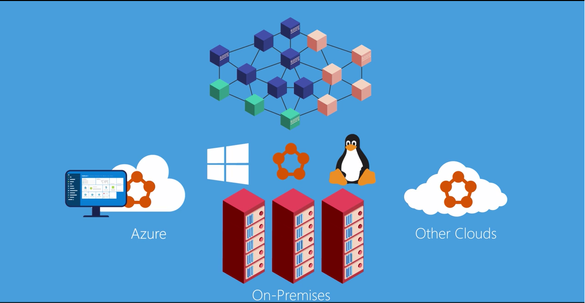
How do I explain this to someone?
Demo
http://aka.ms/servicefabricvideo

Slide 49
Resources
Download the Service Fabric SDK & build applications
http://aka.ms/servicefabricsdk
Learn from samples and complete solutions
http://aka.ms/servicefabricsamples
Learn from the tutorials and videos
http://aka.ms/servicefabricdocs
http://aka.ms/servicefabriccourse
Deploy samples out for free on Azure
http://aka.ms/tryservicefabric
Create Production Cluster
http://aka.ms/sfportal

Slide 50
Thank you!
Rishi Sinha

Slide 51
Microservices placement and failover
Node 100
Node 101
Node 102
Node 103
Node 104
Node 105
P
S
P
P
S
P
S
S
S
S
S
S
P
S
P
S
S
S
S
S
S
S
S
S

